Slide 1
Billit: Easy & Quick Billing at Your Fingertips
Presenting Billit, the Python-based billing software that has been painstakingly designed for dependability, speed, and an incredibly user-friendly interface.

Slide 2
What Makes Billit the Best Option? The Perfected Productivity
Conserve Time and Effort
Created especially to save you time and get rid of the trouble that comes with complicated financial software.
A User-Friendly Interface
A simple interface that anyone can learn in a matter of minutes, guaranteeing instant productivity and no learning curve.
Reliability and Speed
Python was used throughout, ensuring outstanding speed, stability, and dependable operation.

Slide 3
The Problem: You Shouldn't Let Billing Hold You Back
Billit differs from conventional apps in the following ways:Conventional applications:-
Time-consuming interface with intricate menus However,
Billit: User-friendly interface Menu that is simple to use

Slide 4
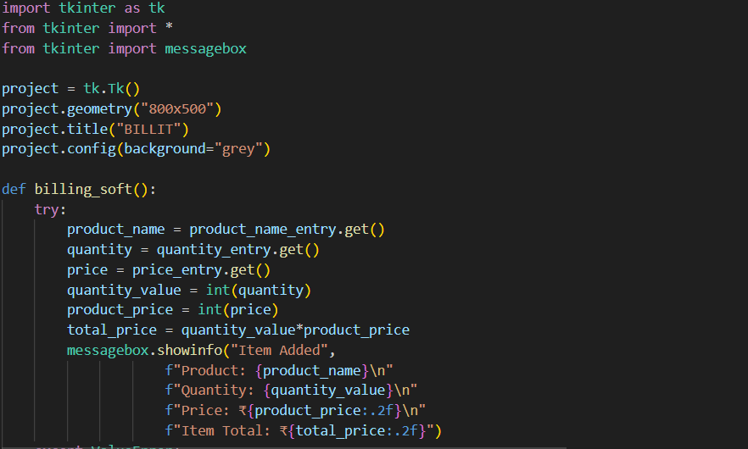
THE REASON THAT MAKES BILLIT SMOOTHR AND BETTER
THE REASON ARE THESE CODES THAT ARE GENERATED TO MAKE THE APP RUN SMOOTH
THESE BASIC HANDWRITTEN CODES ARE CURATED WELL IN A WAY THAT IT PRODUCES THE OUTPUT EFFICIENTLY

Slide 5
An Overview of Billit's Interface: Developed for Explicitness
Simple Layout
We have simple navigation and less clutter, so you can quickly find what you need.
Easy Access
Utilising highly readable fonts and sizable, easily accessible buttons to enable rapid and comfortable data entry and access.
True Responsive Design
Billit functions seamlessly on any screen size4it works perfectly on your desktop, laptop, tablet, and mobile phone. That means you are able to manage and send your invoices and clients from wherever your work takes you, without limitation.

Slide 6
Speed That Impresses: Maximising Efficiency
Calculations in Real Time
As you type, discounts and taxes are automatically calculated, removing human error and guaranteeing accuracy.
Immediate Invoicing
Create polished, expert invoices in a matter of seconds, significantly cutting down on administrative lag time.
A Fast Search
Instant access to contact information, previous invoices, and client history enables quick decision-making.

Slide 7
Behind the Scenes: Using the Power of Python
Robust Error Handling
Advanced mechanisms are in place to anticipate and prevent crashes, providing a truly reliable user experience.
Effective Codebase
With easy syntax and efficient structure, Python provides smooth and low latency performance to support heavy usage demands.

Slide 8
Ready to Bill Smarter?
Billit makes billing:
Billit is fast, simple and easy to use
Try Billit today and take control of your invoicing process. Experience the future of simple, swift financial management

Slide 9
THANKYOU
by:-
Vinayak Goyal
Parth Arora
Vasva Kumar

